Slide 1
Urgent Care Service Management System
Presented by –
Siddhant Kohli
Forum Bhatt
Kinjal Thakkar

Slide 2
ECOSYSTEM
A domain that makes patients' lives easier.
Multiple enterprises can communicate amongst each other for an easier workflow and decreasing complexity.
Helps to track the history of patient.

Slide 3
PROBLEM STATEMENT
Developing communication technologies in a modern healthcare environment, for connecting healthcare professionals with other caretakers and healthcare entities, ensuring the best, most effective, immediate care to patients
Need a single platform for patients to request and track their records

Slide 4
SOLUTION
This application is an improved tracking of the healthcare system that will save you a lot of time and resources for all the entities involved in the system
Each entity in our application has it own share in tracking and providing complete understanding of health risks, medicine demands in the community. This system will help the health authorities to better analyze the risks and manage the health resources
This make Urgent Care Management System as a whole greater than the sum of its parts

Slide 5
OBJECT MODEL DIAGRAM

Slide 6
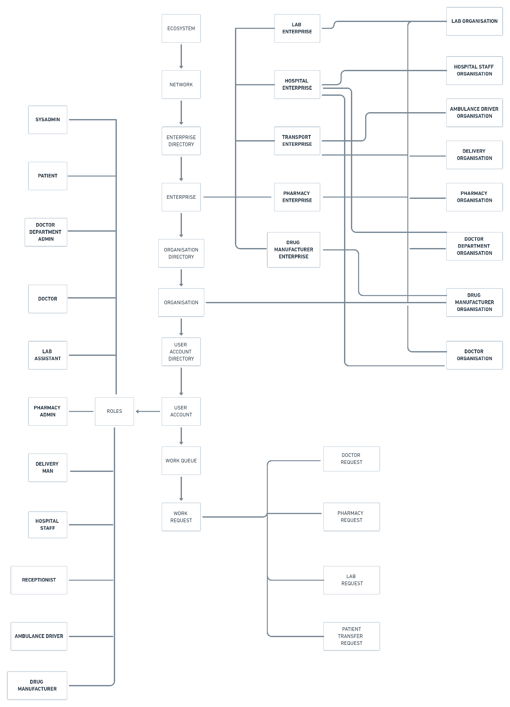

Slide 7
CONCLUSION
Our application provides a better experience for all users of the healthcare system.
It can be further expanded to multiple networks and various enterprise.
The developed application make our system as a whole greater than the sum of its parts.

Slide 8

THANK YOU

